Slide 1
Where’s my money?
Using Agentic Workflows to Automate PaYment Matching in Accounts Receivables

Slide 2
The Premise
Can Agentic Workflows match information from bank statements to an Accounts Receivables ledger and match payments to invoices?
Dataset consists of fictitious accounts receivables, customer information, and payments.
The LLM MUST run locally. No API calls to OpenAI/Claude/Gemini etc.

Slide 3
Why LLMs?
Payment matching is done based on information in the transaction reference.
Can be subjective/ not clearcut if information diverges from standard schema.
E.g. Instead of payment reference as Customer Nr – Invoice Nr – Additional Info -> Additional Info – Customer Nr – Invoice Nr

Slide 4
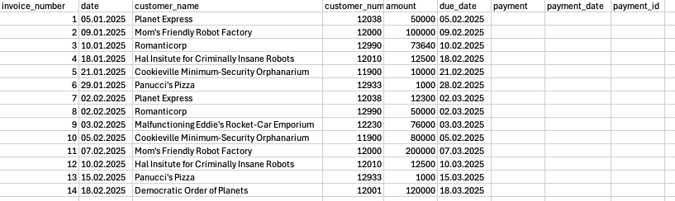

Accounts Receivables
Stored in Postgres
Payment information missing i.e. need to be updated
?!?!?

Slide 5
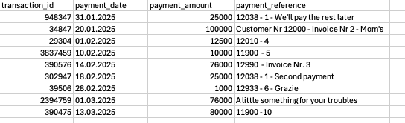
Payments Received
Stored in Postgres
Deviations such as inconsistent references, partial payments etc.

Slide 6
Frameworks, Models, and More
LangChain used as framework for simple workflows.
  LLM decides what tools to use if any.
LangGraph used as a framework specific workflows.
  Useful if LLM needs to access tools in specific order
LangSmith used as a dashboard to monitor and review workflows
Ollama used to run LLMs locally.
  A number of models available.
  Computational resource constraints models ~ 20bn used.

Slide 7
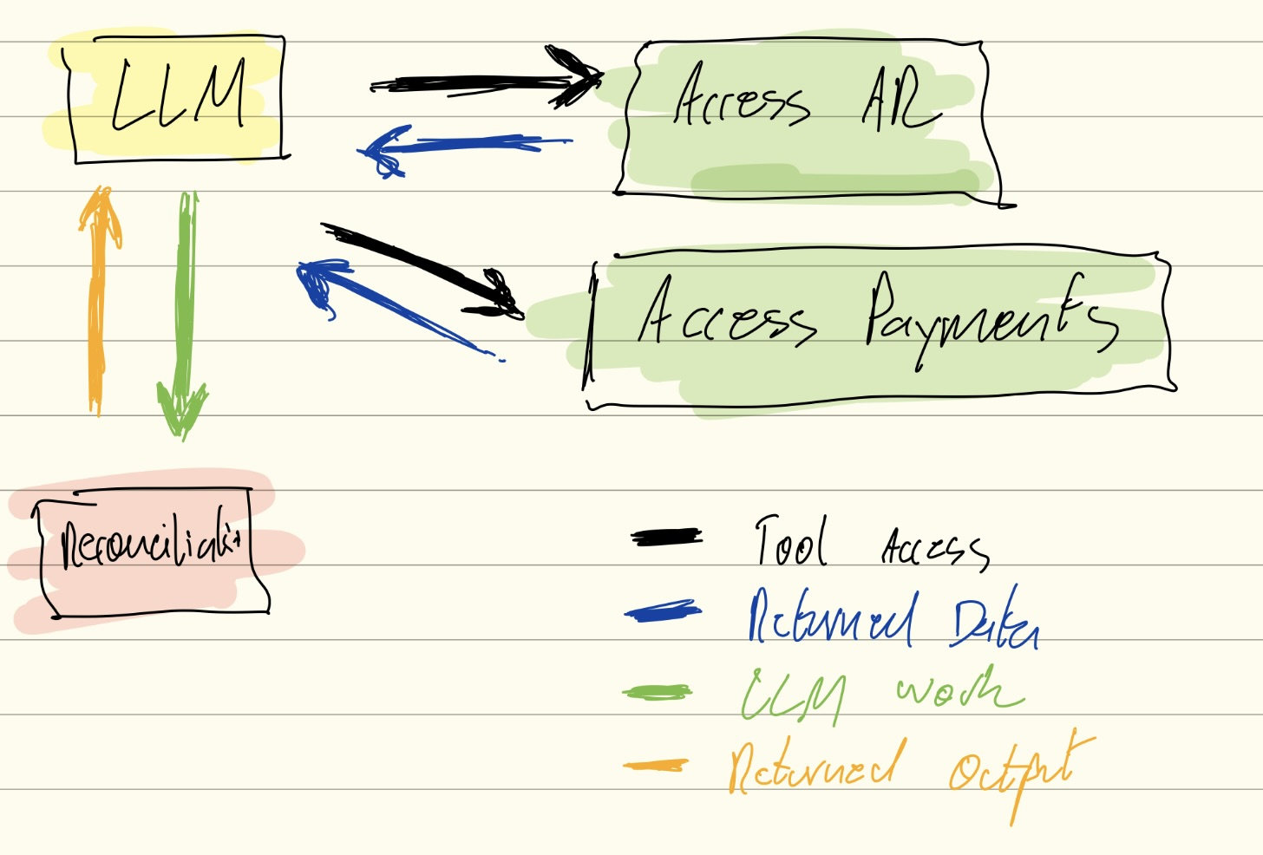
Agentic Workflow Trial 1
The “Here’s some dataframes. Do something with it” approach.
Tool calls access Postgres and return AR and Payments Dataframes
LLM instructed to do reconciliations.
Outcome:
Failed miserably.
Model hallucinated - claimed to have reviewed all payments, no more outstanding invoices etc.
Why?
LLMs work badly with dataframes. Like giving a spreadsheet to a monkey.

Slide 8
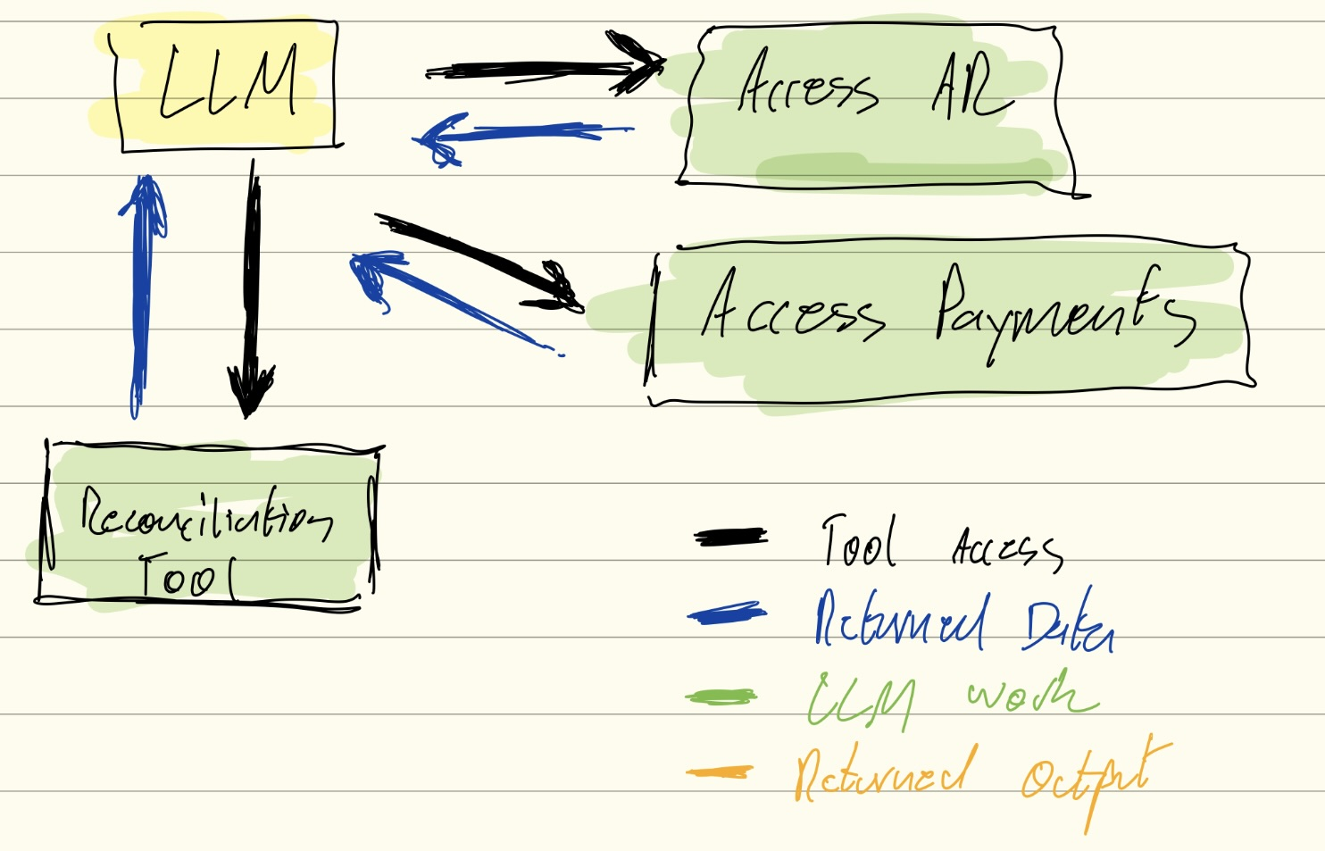
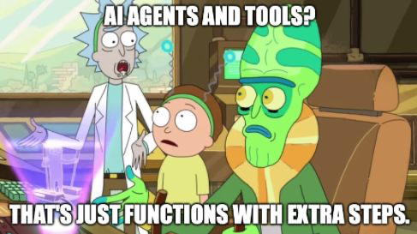
Agentic Workflow Trial 2
The “I wrote a program for you, you just have to call it” approach
Tool calls access Postgres and return AR and Payments Dataframes and does reconciliation.
Outcome:
Mixed results
A lot of effort for simple task
With LangChain Framework, wouldn’t call tools in order,
despite instruction
With LangGraph could set order BUT
setup defeated purpose of using AI for decision making.

Slide 9
Agentic Workflow Trial 3
The “Go back to basics approach”.
Model | Accuracy | Comments
gpt-oss:20bn | Best | Took the longest. Ca. 1 Hour
Qwen3:8bn | Good | Took ca. 30 mins
Llama3.2: 3bn Llama3.1: 1b Llama3.1:8bn | Are you even trying? | Fast but poor results. Failed with anything unusual.
Refocus on underlying data used when calling LLMs.
String Input –String Output
Rewrote tools to return dataframe as a dictionary string.
Left out reconciliation tool
Outcome:
Overall success
Accuracy depended on strength of model.
Some powerful local LLMs do not support tool calling such as DeepSeek-R1.

Slide 10
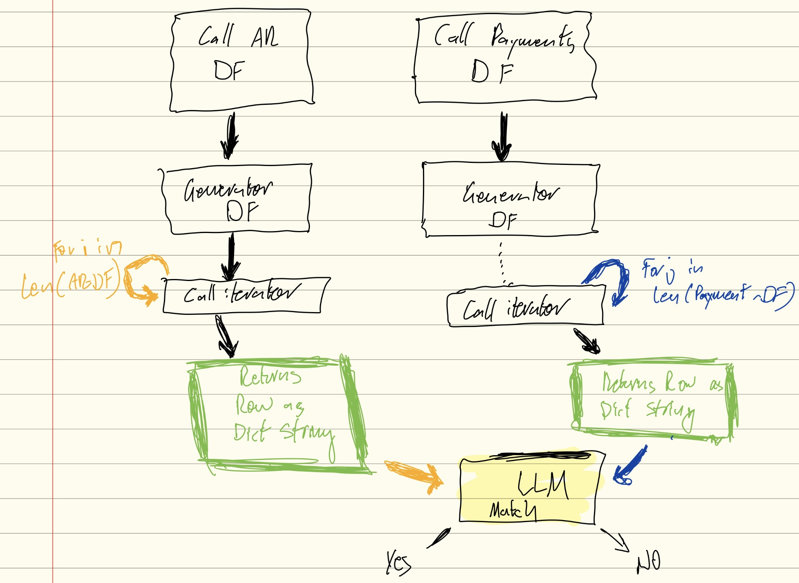
Agentic Workflow Trial 4
Just… one…more…turn
No Tool calling -> can use other models
Use generators to iterate through DF rows of AR and Payments:
Row one of AR go through each row of Payments to see if match.
All data used in string format.
Outcome:
Similar to Trial 3
Deepseek was best for speed and accuracy.
Ca 1 minute per row for accurate models -> Can end up taking a lot of time for larger DFs.

Slide 11
Learning Outcomes
Write good and clear prompts. Using capital letters for emphasis does work.
Make sure you work with data types the model understands:
  Get really good with learning PyDantic for data models
Models from about 8bn parameters work best for subjective tasks.
Tools should provide data or enable calculations (some LLMs can’t do calculations).

